Slide 1
Fetal Heart Rate Monitoring Array
Matt Brown, Grace Lee, Varun Rao
Group 35
Dr. Kristen Naegle
Senior Capstone Design
October 10th, 2016

Slide 2
Overview
Background
Exact Need
Project Scope
Current Technology and Techniques
Doppler Ultrasound
Phonocardiography (PCG)
Electrocardiography (ECG)
Magnetocardiography (MCG)
Design Specifications
Design Schedule/Responsibilities
Questions

Slide 3
Background
Client - Dr. Kristen Naegle
Washington University - Department of Biomedical Engineering
Developed idea during pregnancy with twins
Many issues with fetal heart rate detection
Uncomfortable for mother
Dangerous for fetus
Demands much effort from provider
Whitaker Hall - Home of WUSTL BME Department Source: Google Images

Slide 4
Exact Need
Distinguish between multiple fetal heart rates
Not just twins
Minimize constant care from provider
Comfortable for mother
Alert provider if fetal HR is abnormal

Slide 5
Project Scope
Prototype Overview
Hardward
Circuit creation
Acquire, filter, amplify signal
Software
Signal processing algorithm
Determine if irregularities exist

Slide 6
Current Technology and Techniques

Slide 7
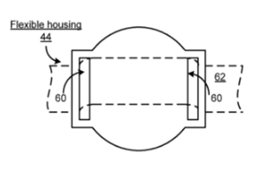
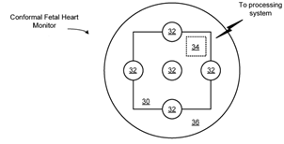
Doppler Ultrasound
Uses Doppler effect to monitor blood flow
Change in frequency translated to an image
ΔF = F_{R} - F_{T}
Very accurate signal collection
Trouble distinguishing odd HR patterns
Very expensive
US 20130261464 patent for fetal heart rate monitor with strap (right) and wireless transducer and circuit model (left). Source: [6]

Slide 8
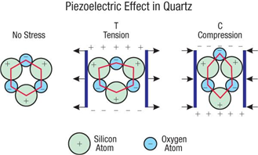
Phonocardiography
Capture audio signal that corresponds to mechanical movements of valves.
PIezoelectric transducers
Atomic structure deformed
Pressure or force responding
Electrical charge change
Charge builds up to electrical signal
Heartbeat pressure
Relatively Inexpensive
Low accuracy and noise
Piezoelectric effect representing charge difference in quartz as a response to applied force. Source: [8]

Slide 9
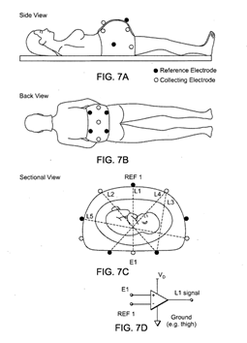
Electrocardiogram
Signal measured is electric potential of heart
fECG
Pan Thompkins algorithm
QRS identifier
Distinguish maternal heartbeat
Band pass filter
Multivariate Singular Spectrum Analysis (MSSA)
Nonlinear continuous signals
Less noise
Singular value decomposition to remove maternal HR
Cheap and portable
High noise and tiny signal
US 20120083676 A1 patent for MSSA fetal heart rate monitor. Source: [12]

Slide 10
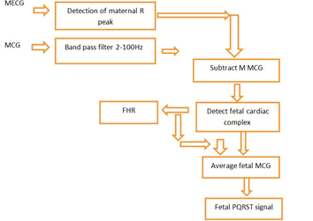
Magnetocardiogram
B field created by E field of heart
Cannot calculate signal in real time
Long signal processing time
Combine ECG and MCG
Extremely safe method
Very small signal and high cost
Processing System that utilizes both MCG and ECG to determine fetal heart rate. Source: [13]

Slide 11
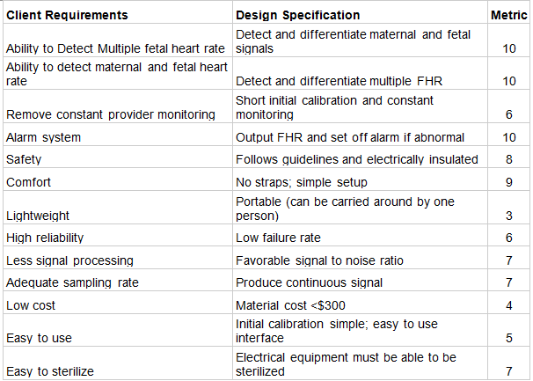
Design Requirements and Specifications

Slide 12
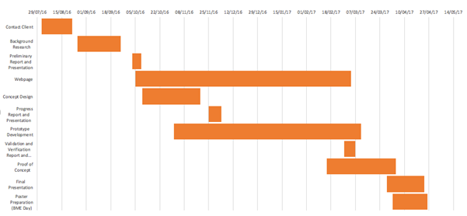
Design Schedule

Slide 13
Teammate Responsibilities
Matt Brown
Preliminary Presentation, Scheduling and Material Ordering, Circuit Design, PCG Evaluation
Grace Lee
Verification & Validation, Circuit Design, Website Management, Doppler Evaluation
Varun Rao
Progress Report, Algorithm Development, ECG and fMCG Evaluation

Slide 14
Questions?

Slide 15
Sources
[1] Butler Tobah, Yvonne, M.D S., M.D., Julie A. Lamppa, APRN, CNM, and Myra J. Wick, M.D., PhD. "Fetal Ultrasound." Mayo Clinic. Mayo Clinic, 19 Sept. 2015. Web. 4 Oct. 2016.
[2] Freudenrich, Craig C., PhD. "How Ultrasound Works." How Ultrasound Works. University of Toronto, n.d. Web. 05 Oct. 2016.
[3] Maulik, Dev. "Biological Safety." Doppler Ultrasound in Obstetrics & Gynecology. New York: Springer, 1997. N. pag. Print.
[4] Radiological Society of North America (RSNA) and American College of Radiology (ACR). "General Ultrasound." Ultrasound (Sonography). Radiological Society of North America (RSNA) and American College of Radiology (ACR), 30 May 2016. Web. 04 Oct. 2016.
[5] Gagnon, R., and M. Van Den Hof. "Result Filters." National Center for Biotechnology Information. U.S. National Library of Medicine, 25 July 2003. Web. 05 Oct. 2016.
[6] J, Adam. "The Future of Fetal Monitoring." Reviews in Obstetrics and Gynecology. MedReviews, LLC, 2012. Web. 05 Oct. 2016.
[7]Kovács, Ferenc, Csaba Horváth, Ádám T. Balogh, and Gábor Hosszú. "Fetal Phonocardiography—Past and Future Possibilities." Computer Methods and Programs in Biomedicine 104.1 (2011): 19-25. Web.
[8] "Technology: Piezoelectricity." News. Tired Tires. Web. 6 Oct. 2016.
[9] Singh, Rahul, Martin Culijat, Richard Brand Caso, and Jim Selevan. Conformal Fetal Heart Monitor and System for Use Therewith. Rahul Singh, Martin Culjat, Richard Brand Caso, Jim Selevan, assignee. Patent US 20130261464 A1. 03 Oct. 2013. Print.
[10] Rajput, Priya, Singh. “Fetal Heart Monitor.” International Journal of Scientific Research and Engineering
[11] Abdulhay, Owels. "Review Article: Non-Invasive Fetal Heart Rate Monitoring Techniques." Review Article: Non-Invasive Fetal Heart Rate Monitoring Techniques. Science and Education.
[12] Fetal Heart Rate Monitor. Patent US20120083676.
[13] Rasu, R., P. Shanmuga Sundaram, and N. Santhiyakumari. "FPGA Based Non-invasive Heart Rate Monitoring System for Detecting Abnormalities in Fetal." 2015 International Conference on Signal Processing and Communication Engineering Systems (2015)
[14] Pichamuthu, Kishore, MD, DNB, MRCP, EDIC. "Tutorial 1 - Basic Physics of Ultrasound and the Doppler Phenomenon." ICU Sonography. Christian Medical College Hospital, 2009. Web. 05 Oct. 2016.
[15] US Food and Drug Administration, “Proper Use of Ultrasound Equipment Pursuant to a Prescription Ensures That a Woman Will Receive Professional Care That Contributes to Her Health and to the Health of Her Fetus.”. "Avoid Fetal "Keepsake" Images, Heartbeat Monitors." Avoid Fetal "Keepsake" Images, Heartbeat Monitors. US Food and Drug Administration, 16 Dec. 2014. Web. 04 Oct. 2016.

