Slide 1
FETAL HEART RATE MONITOR
Varun Rao
Partners: Grace Lee, Matt Brown
Client: Professor Naegle

Slide 2
Project Scope
Distinguish between multiple (at least 2) fetal heart rates and maternal heart rate
Minimize constant care from healthcare provider
Ensure comfort for mother

Slide 3
Design specifications
Specification | Description
Implementation | Our device should be able to isolate and differentiate between at least 2 fetal heart rates and the maternal heart rate. Additionally, both fetal heart rates and maternal heart rate should be outputted at a frequency of 100 Hz.
Accuracy | Fetal heart rate and maternal heart rate should be accurate to within 10%
Comfort | No repositioning required, setup time < 5 minutes and removal time < 1 minute for health practitioner
Preprocessing | Output heart rate must be displayed in real time, which is dependent on minimizing amount of signal processing used and signal-noise ratio
Cost | Less than existing solutions (Barnes-Jewish uses a $5,000 machine)
Lightweight | Recording equipment should be < 3lbs
Safety | Meet standards IEC 60601 – 1 (Safety and Effectiveness of Medial Equipment)

Slide 4
Potential Design Solutions
Electrocardiography
Pans-Tompkins with Array of Recording Electrodes
Multivariate Singular Spectrum Analysis (MSSA)
Fast Independent Component Analysis
Sensor Selection with Array of Recording Electrodes
Phonocardiography
Abdominal Microphone
Abdominal Microphone + Open Air Microphone
Array of Abdominal Microphone + Open Air Microphone
Doppler Ultrasound
Doppler Ultrasound Transducer
Transducer with Moving Instructions

Slide 5
Potential Design Solutions
Electrocardiography
Pans-Tompkins with Array of Recording Electrodes
Multivariate Singular Spectrum Analysis (MSSA)
Fast Independent Component Analysis
Sensor Selection with Array of Recording Electrodes
Phonocardiography
Abdominal Microphone
Abdominal Microphone + Open Air Microphone
Array of Abdominal Microphone + Open Air Microphone
Doppler Ultrasound
Doppler Ultrasound Transducer
Transducer with Moving Instructions

Slide 6
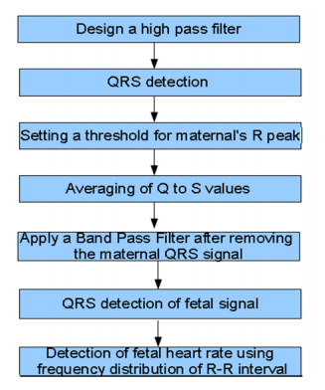
Pans-tompkins
Filtering to remove baseline wandering
Pans-Tompkins Algorithm
Derivative to detect based on slope
Squaring to emphasize QRS complex
Integration to smooth out multiple peaks per complex
Thresholding to detect peaks
Isolate maternal ECG
Repeat Pans-Tompkins for fetal ECG

Slide 7
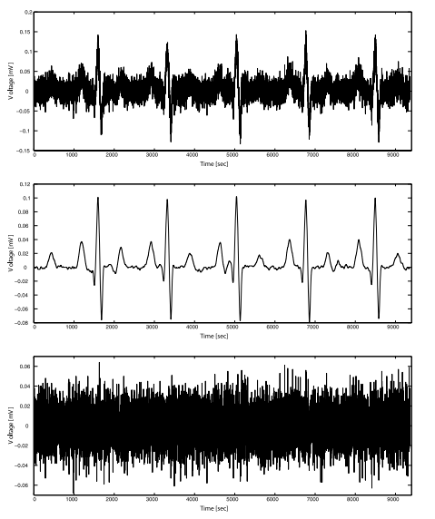
Multivariate Singular Spectrum Analysis (MSSA)
Decomposition
Embedding – transform to higher dimensional space
Singular Value Decomposition – decompose into multiple orthogonal components
Reconstruction
Grouping – group components using eigentriple grouping
Reconstruction – diagonal averaging to obtain Hankel matrix which can then be converted into a time series
Noisy ECG (top), Isolated ECG (middle), Isolated Noise (bottom)

Slide 8
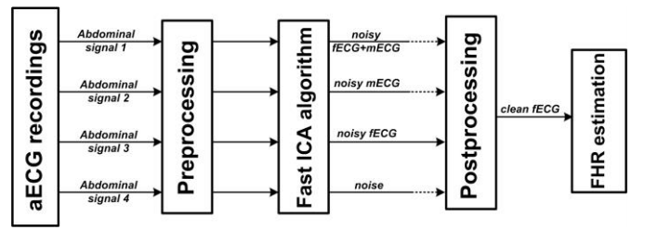
Fast Independent Component Analysis (fica)
Preprocessing
Remove baseline wandering and power line interference at 50 Hz (if necessary)
fICA algorithm
Assume input signal is a linear combination of weighted input signals
Determine demixing matrix to obtain original signals
Postprocessing
Filter out high frequency noise

Slide 9
Sensor Selection
Utilizes array of recording electrodes
Best recording electrode output chosen based on minimizing cost function
Cost function measures differences between each electrode and a reference electrode
Reference electrode output is textbook ECG signal
High costs would imply high noise or output with elements of other ECG signals

Slide 10
Potential Design Solutions
Electrocardiography
Pans-Tompkins with Array of Recording Electrodes
Multivariate Singular Spectrum Analysis (MSSA)
Fast Independent Component Analysis
Sensor Selection with Array of Recording Electrodes
Phonocardiography
Abdominal Microphone
Abdominal Microphone + Open Air Microphone
Array of Abdominal Microphone + Open Air Microphone
Doppler Ultrasound
Doppler Ultrasound Transducer
Transducer with Moving Instructions

Slide 11
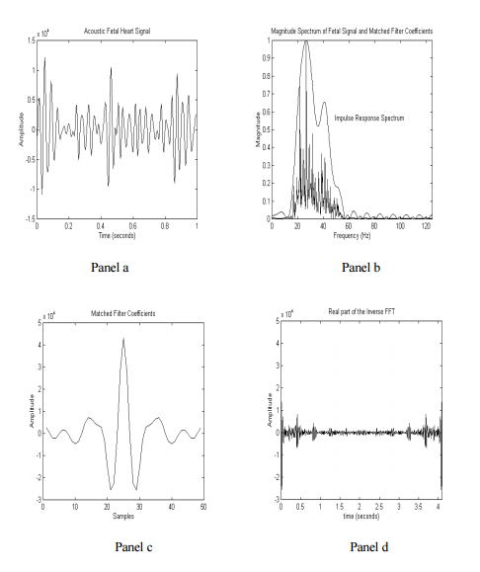
PHonocardiography
Fast fourier transform (FFT) applied to input signal
Envelope Generation
Squaring FFT to demodulate the signal
Filtering out high frequency content
Down sampling to reduce aliasing
Square root to reverse scaling distortion
Threshold applied to envelope to obtain periodicity and rate of fetal heart signal
FHR signal in real time (TL). Average magnitude spectrum (TR). Matched filter coefficient (BL). Inverse FFT (BR)

Slide 12
Abdominal Condenser Microphone
Condenser microphone placed near abdomen
Collects audio signal of fetal heart
Utilizes the piezoelectric effect to convert mechanical pressure of sound waves to electrical signal
Signal processed to detect fetal heart rate

Slide 13
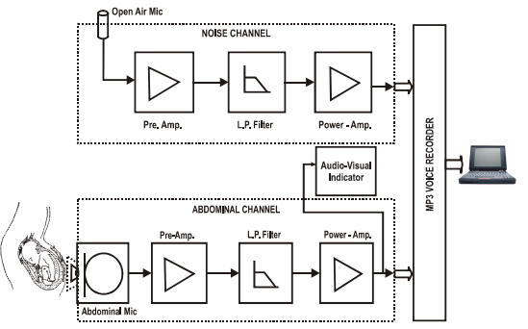
Abdominal Microphone with Open Air Microphone
Abdominal microphone records acoustic signal from fetal heart
Open air microphone used to detect air noise signal
Noise signal weighted as shown below
d(k) = s(k) + n(k)
y(k) = n’(k) * w(k)
e(k) = d(k) - y(k)
w(k+1) = w(k) + e(k)*n’(k)
Noise is removed from input signal

Slide 14
Potential Design Solutions
Electrocardiography
Pans-Tompkins with Array of Recording Electrodes
Multivariate Singular Spectrum Analysis (MSSA)
Fast Independent Component Analysis
Sensor Selection with Array of Recording Electrodes
Phonocardiography
Abdominal Microphone
Abdominal Microphone + Open Air Microphone
Array of Abdominal Microphone + Open Air Microphone
Doppler Ultrasound
Doppler Ultrasound Transducer
Transducer with Moving Instructions

Slide 15
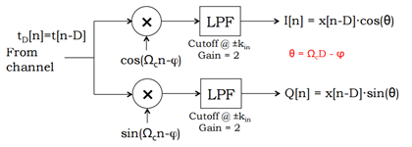
Doppler Ultrasound
Quadrature Demodulation
Accounts for the phase error between sending and receiving signals
Sender and receiver must share a clock
Crosstalk, where the I and Q signals bleed into each other, needs to be avoided
Autocorrelation
Dot product of signal with itself delayed by a time interval

Slide 16
Array of Doppler Ultrasound Transducers
Minimize repositioning
One transducer is bound to get the best signal
Signal strength used to choose the best transducer
Autocorrelation to determine the periodicity of the signal
Thresholding to determine heart rate

Slide 17
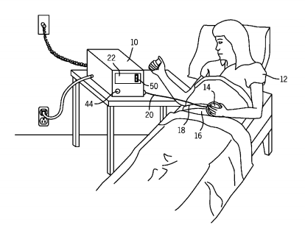
Positional Feedback Doppler Transducer
Transducer will indicate repositioning is required using display
As transducer is moved, display will indicate one of the cardinal directions where signal strength is high
When fetal heart rate can be outputted, display will indicate that no further repositioning is required

Slide 18
Pugh Analysis
Specification | Weight | Pans-Tompkins | Fast ICA | Sensor Selection Algorithm | Abdominal Array and Open Air | Multiple Doppler Ultrasound
Implementation | 10 | 7 | 10 | 8 | 9 | 9
Accuracy | 8 | 7 | 8 | 5 | 8 | 6
Comfort | 8 | 9 | 4 | 9 | 9 | 2
Preprocessing | 9 | 9 | 8 | 6 | 8 | 6
Cost | 4 | 10 | 10 | 10 | 7 | 4
Lightweight | 6 | 8 | 8 | 8 | 5 | 3
Safety | 8 | 10 | 10 | 10 | 8 | 8
Total |  | 447 | 436 | 414 | 420 | 292

Slide 19
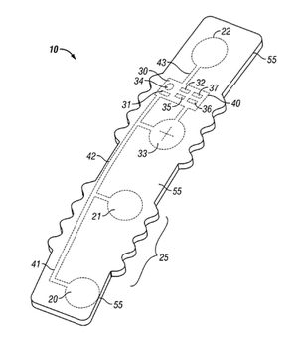
Pan-Tompkins with Array of Recording Electrodes
Utilizes multiple recordings taken from abdominal patch of electrodes
Sensor selection can be based on signal strength or utilizing our designed sensor selection algorithm
Detection of maternal QRS complex using Pans-Tompkins and removing it by averaging Q and S values
Detecting QRS complex and utilizing R-R peak interval to determine fetal heart rate

Slide 20
Proposed Budget
All of our materials can be obtained from the BME labs.
Cost shown below only required if we were to upgrade our design materials.
Array of electrodes - $100
Abdominal patch - $20
Physical fetal model - $20
Total - $140

Slide 21
Questions

