Slide 1
Fetal Heart Rate Monitor V&V Presentation Group 35 Grace Lee Matt Brown Varun Rao Client Professor Naegle

Slide 2
Need and Scope
Design Specs
Design Schedule
Team Responsibilities
V&V Plan
CONTENTS

Slide 3
Project Need and Scope
Need
No current satisfactory fetal heart rate monitoring techniques for pregnancies with more than one fetus.
One doppler ultrasound transducer is required for each fetus
Scope
Develop a hardware and software solution that determines fetal heart rate
Minimize the need for constant provider care
Ensure comfort for mother
Notes:
Our project need and scope remain the same. Our project need arises from the fact that there are no current satisfactory fetal heart rate monitoring techniques for pregnancies with more than one fetus. As of now, one doppler ultrasound transducer is required for each fetus, which is a hassle for both health professionals and patients. As such our project scope is defined as developing a hardware and software solution that determines fetal heart rate without the need for constant healthcare provider care required for current methods.

Slide 4
Design Specifications
Specification | Description
Implementation | Isolate at least two fetal heart rates from maternal ECG recordings
Output | Heart rate outputted every 5 seconds
Accuracy | Fetal heart rate accurate to within 10% of fetal scalp ECG
Comfort | No repositioning required, setup time under 5 min and removal under 1 min for health practitioner
Cost | Less than existing solutions (Barnes-Jewish uses a $5,000 machine)
Lightweight | Recording equipment should be < 3 lbs.
Safety | Meet standards of IEC 60601 – 1 (Safety and Effectiveness of Medical Equipment)
Notes:
Only significant change is our output specification which says that the fetal heart rate will be outputted every 5 seconds.

Slide 5
Design Schedule
Continue developing prototype
Final presentation and poster
Design Safe analysis
Follow V&V plan and test prototype
Notes:
On track, update scinote and website in between

Slide 6
Team Responsibilities
Preliminary presentation, circuit design
V&V presentation, circuit design, website management
Progress presentation, algorithm development
Fluid responsibilities
Notes:
Fluid as in we share responsibilities so everyone can take put in effort in every part

Slide 7
Verification and Validation Plan – Recording setup
Obtain maternal abdominal electrocardiogram data
Filter data to attenuate noise
Implement data buffer
Data is passed from data buffer to processing algorithm
Determine fetal heart rate
Notes:
We will test out our recording setup to ensure that it can record electrocardiogram data when placed on the abdomen by using it on ourselves. Determining a heart rate every 5 seconds will ensure that our buffer is implemented correctly. Through this, we will test our output design specifications.

Slide 8
Verification and Validation Plan – Abdominal patch
Skin irritation and adhesiveness to skin
Skin preparation
Band-aid lattice
Hydrocolloid dressing
Electrode mesh
Lattice may fall apart
Electrodes do not adhere together
Notes:
Test safety, cost, comfort and lightweight specifications.
To test that the above ideas work, we will create a prototype and use the prototypes on our abdomen. We will use the prototypes for 15 minutes, 30 minutes, 1 hour, 5 hours, and 10 hours to see how irritated the skin gets. In addition, we will remove and reattach the prototypes to figure out when the adhesiveness starts to fail, and how irritated the skin gets with applying the prototype.

Slide 9
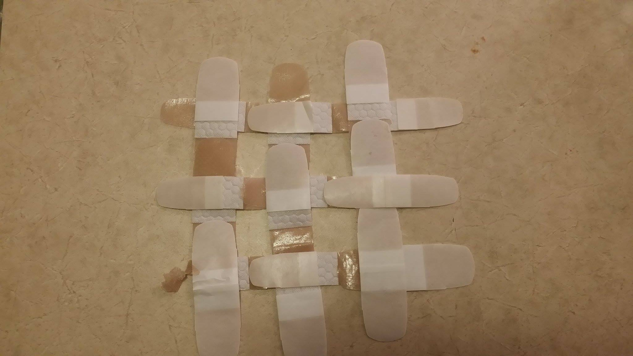
Verification and Validation Plan – Abdominal patch
Notes:
Here is a video and some images from testing
Lattice hard to detach from surface after making; band-aids stick together; area with cotton doesn’t stick

Slide 10
Verification and Validation Plan – Software
Raw data from abdominal and direct fetal electrocardiogram database
data from 4 patients
Input: 5 s of maternal abdominal data
Processing: ICA algorithm
Output: calculated heart rate
Create mixing matrix and combine maternal and fetal ECG of different patients
Isolate fetal ECG and compare with fetal scalp ECG
Use animal ECG
Notes:
Test implementation, output, accuracy,
Obtained raw data from european maternal and fetal ECG database. Preprocess the maternal data after the electric filtering. This would remove high frequency noise and the power line frequency noise. Input to our ICA algorithm and postprocess the fetal ECGs before testing heart rate.
Since, we only have single fetus data, we need to find a way to test it out on multiple fetus data. To do this, we can combine maternal abdominal data with fetal data from a different patient. Alternatively, we can try to find animal ECG data with multiple fetuses.
Direct fetal electrocardiogram data is how we test our accuracy specification. By isolating fetal ECGs, we will also validate that we accomplished our implementation specification. Once we finish this validation, we will have tested all of our specifications.

Slide 11
References
[1] “Fetal ECG Extraction from Multichannel Abdominal ECG Recordings for Health Monitoring during Labor” Fetal ECG Extraction from Multichannel Abdominal ECG Recordings for Health Monitoring During Labor – Science Direct Mar, 2017.
[2] Ionescu et al. “Fetal Heart Rate Detection and Monitoring from Noninvasive Abdominal ECG Recordings.” IEEE Conference on E-Health and Bioengineering 2015
[3] Ghodsi’s, “Isolate Signals from noisy ECG by multivariate singular spectrum analysis” Statistics and its Interface 2010
[4] Pan, Jiapu, and Willis J. Tompkins. "A Real-Time QRS Detection Algorithm." IEEE Transactions on Biomedical Engineering BME-32.3 (1985): 230-36. Web.
(Image) https://femalereport.wordpress.com/2014/01/24/news-the-big-lie-in-putting-off-pregnancy-cnn/

Slide 12
Fetal Heart Rate Monitor V&V Presentation Questions Thank you

